Slide 1
BC’s new Core French curriculum redesign
BCATML Twitter Chat
Wednesday, May 6th, 2015 at 6:00 pm
Use hashtag #BCATML in your tweets
Hosted by:
BCATML
bcatml.weebly.com
@BCATML

Slide 2
Why write new curricula?
Make curriculum more flexible, innovative & personalized;
Reduce prescriptive nature of current curricula while ensuring a solid focus on essential learning;
Focus new curricula on higher order learning
Make explicit the cross-curricular competencies that support life-long learning
Integrate Aboriginal worldviews and knowledge
Develop assessment & evaluation programs that align with the changed emphases in curriculum
Notes:
To better enable teachers to innovate and personalize learning.
Give emphasis to key concepts and enduring understandings (Big Ideas) that students need to succeed in their education and lives.

Slide 3
How has input been gathered for new curriculum?
Ministry of Education call for professional input
Committee formed of different stakeholder groups:
Public schools,
Private schools,
Specialist and Generalist teachers,
Administrators,
BCTF: le Conseil Consultatif de services français
Faculty of Education
Provincial Specialist Associations (BCATML)
Notes:
The Core French Curriculum Working Group committee is composed of 12 members from BC’s public and private schools, classroom teachers and administrators, elementary and secondary teachers, generalists and specialist teachers, Core French, Intensive French and French Immersion teachers.

Slide 4
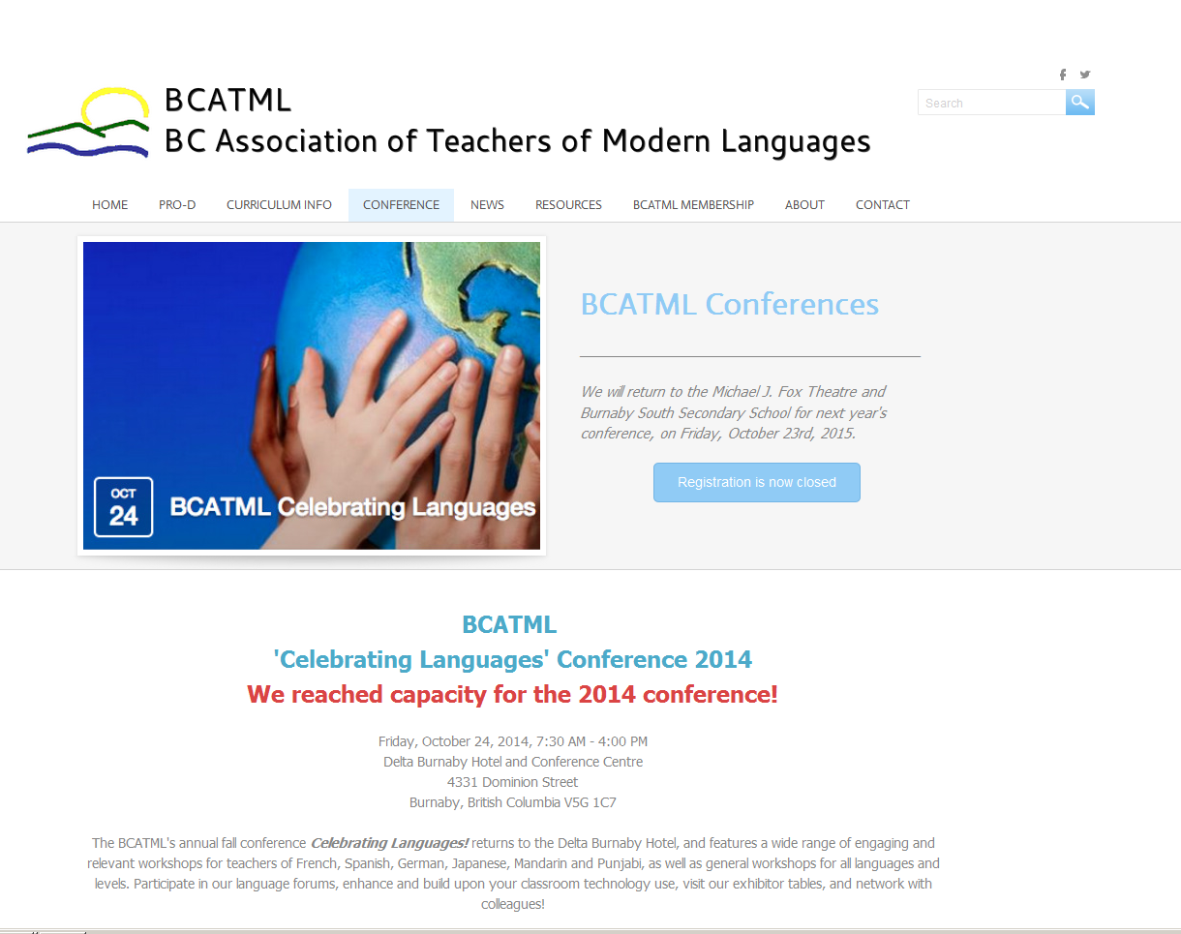
Notes:
Ministry of Education offered two workshops at BCATML 2015 Fall Conference explaining the curriculum redesign process and asked for teachers’ input and insight.

Slide 5
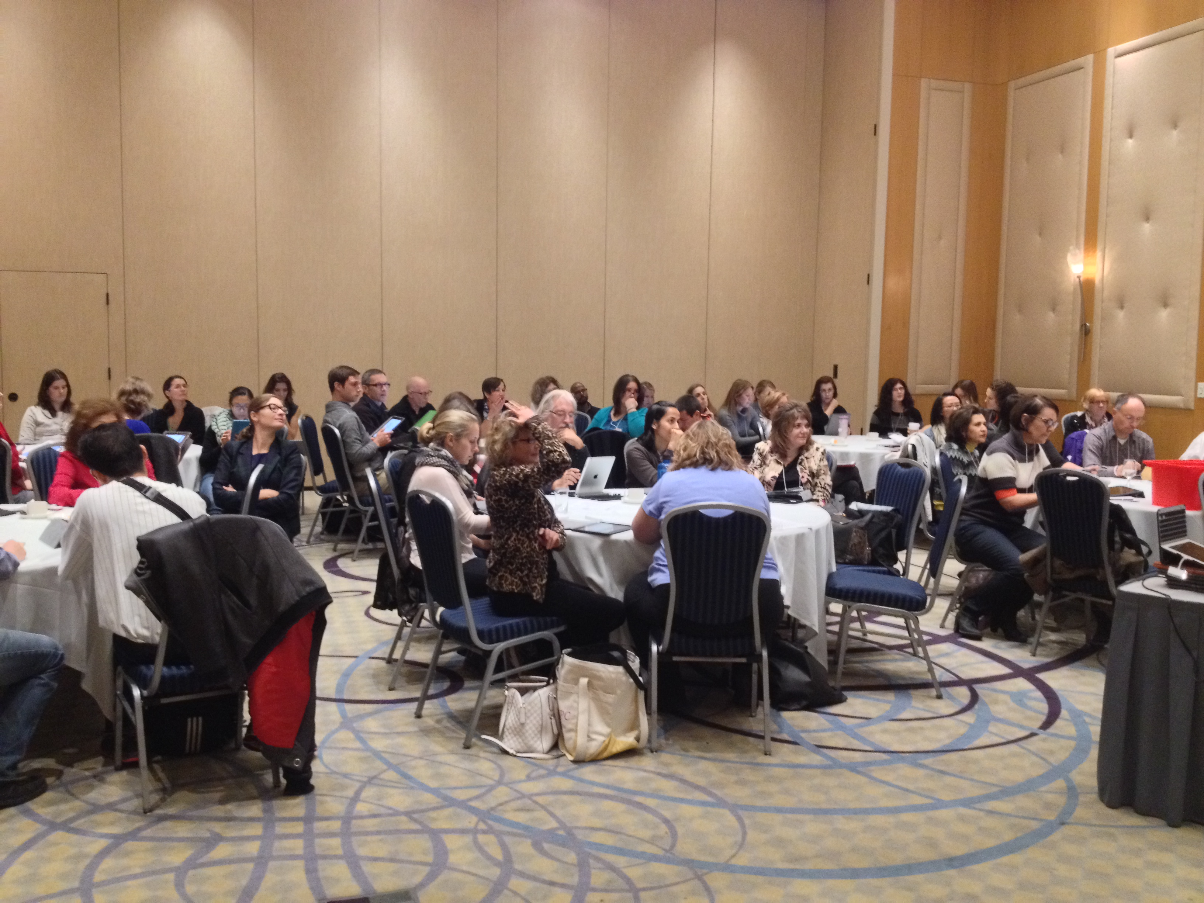
BCATML Celebrating Conference – October 2015
BC Teachers provided their wishes and desires for new curriculum onto chart paper
Notes:
Over 375 teachers, educators, administrators and other stakeholders attended this conference.

Slide 6
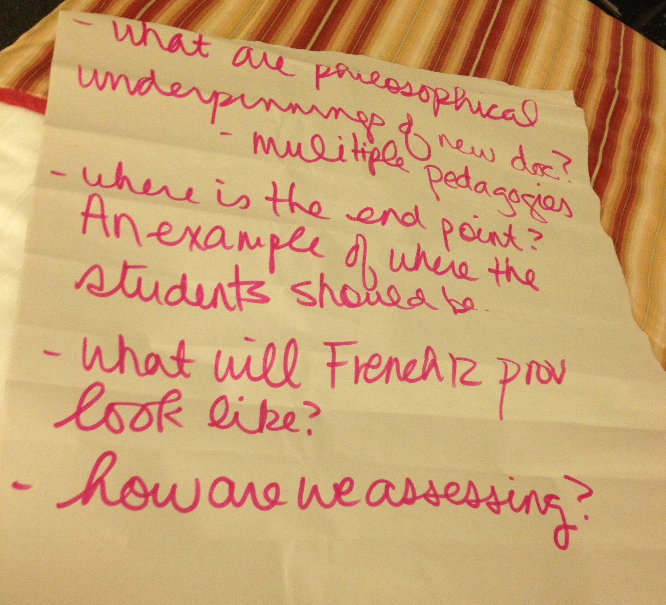
Notes:
BC Teachers were asked to write and share their insight for the new Core French curriculum.

Slide 7
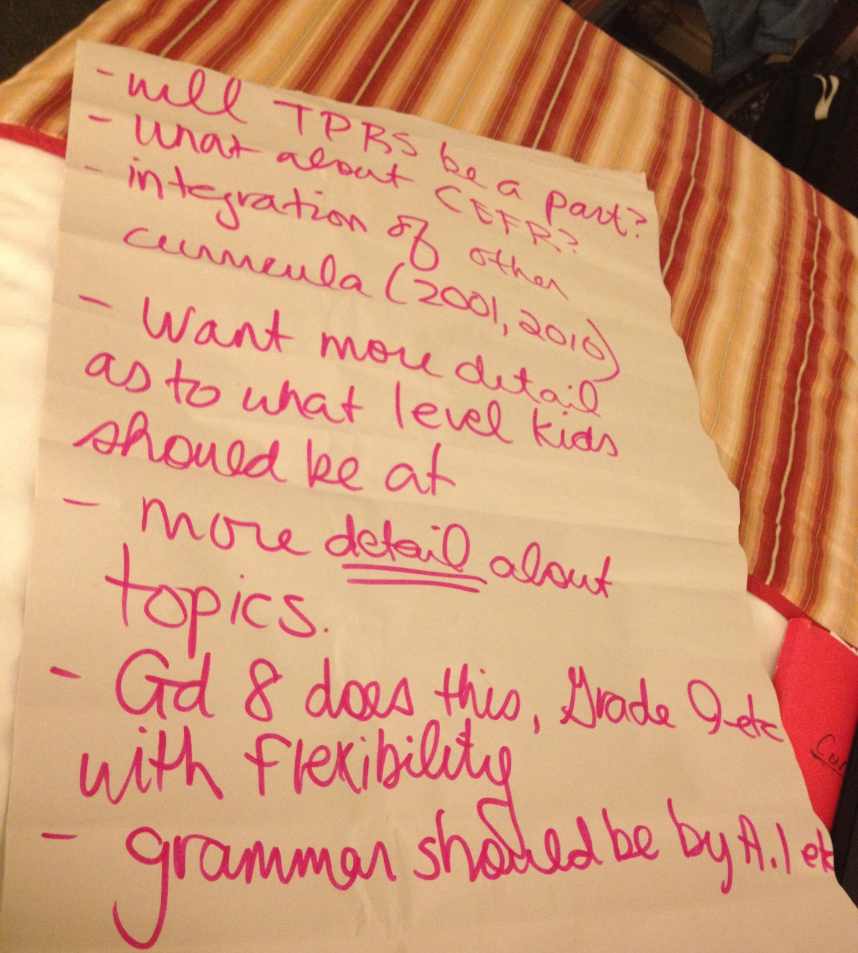
Notes:
Ministry of Education collected the feedback from the BCATML Conference. These ideas/comments were reviewed by the entire committee and kept in the forefront for the redesign process.

Slide 8
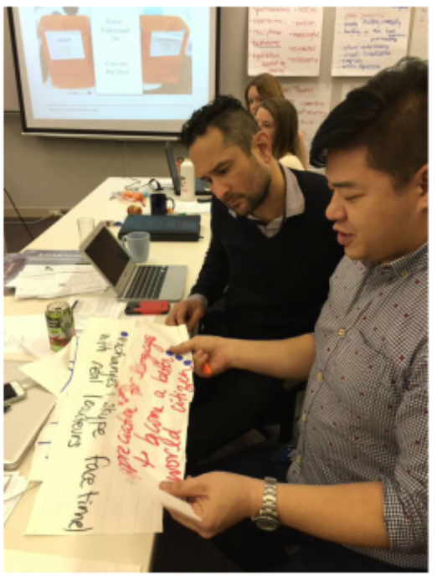
Consolidating teachers’ wishes for new curriculum
Notes:
Teachers’ feedback and input were then reviewed by the whole committee and compiled together to laydown the foundation for the new curriculum.

Slide 9
What can one expect in the new curriculum?

Slide 10
Notes:
The new curriculum will foster a growth mindset towards learning.

Slide 11
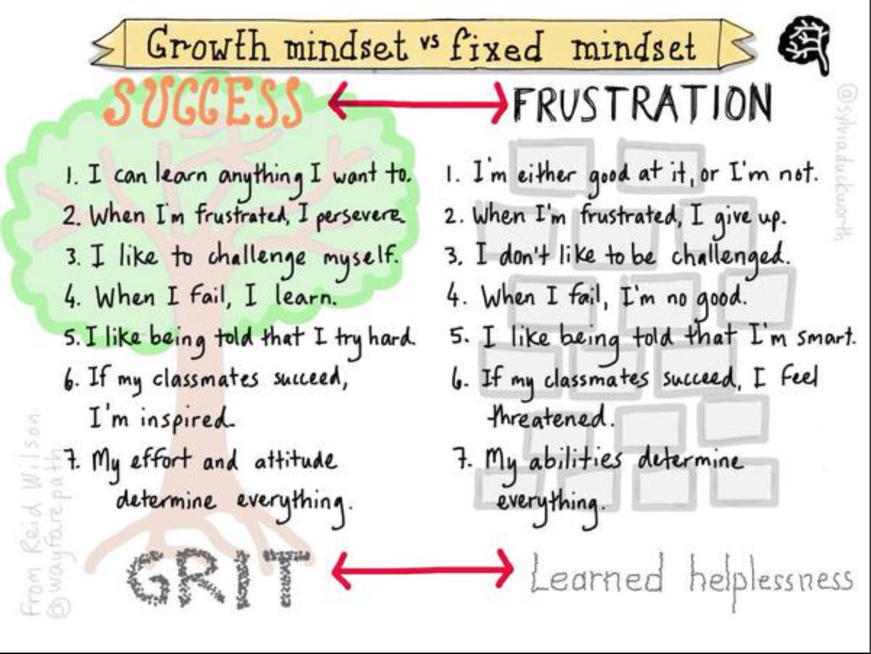
Notes:
Paradigm shift from a fixed mindset to a growth mindset.

Slide 12
Notes:
FNESC’s First Peoples Principles of Learning will be woven in the new curriculum.

Slide 13
Notes:
Many of the Principles of Learning lend themselves readily to learning Core French and additional languages

Slide 14
Notes:
First Peoples Principles of Learning continued.

Slide 15
Notes:
The new curriculum will focus on developing the Educated Citizen and embody 21st Century learning philosophies.

Slide 16
The 2015 Core French Curriculum
What’s new?
What’s stayed the same?
Educated Citizen, 21st Century Learning
First Peoples Principles of Learning
3-D learning, KDU model
Social media
Integration of culture
Learners reflect on their own culture and identity
Using culture to further one’s own learning
Authentic tasks and situations
Communicative & Experiential approach
Curricular competencies are similar to CEFR “Can-do” statements and situations
Language acquisition and skills for: reading, writing, spoken interaction, spoken production and listening
Notes:
How will the Core French curriculum differ from and resemble the 2001 and 2011 (draft) curricula?

Slide 17
Elements of BC’s new curricula:
Core Competencies
Goals
Content & Concepts
Curricular Competencies
Big Ideas
Notes:
All of BC’s new curricula will use a similar template broken into the following categories: Core Competencies, Goals, Content & Concepts, Curricular Competencies and Big Ideas.

Slide 18
Core Competencies:
Set of intellectual, personal, social and emotional proficiencies that students need to develop in order to engage in deeper learning
They include:
Thinking competencies
Communication competencies
Social & personal competencies

Slide 19
Core Competencies:
Thinking Competency
Critical thinking
Creative thinking
Communication Competency
Oral, written, visual, digital; includes collaboration & reflection
Social and Personal Competency
Positive personal and cultural identity
Personal awareness and responsibility; self-regulation
Social awareness and responsibility
Notes:
Core Competencies refer to Thinking Competency, Communication Competency and Social and Personal Competency.

Slide 20
Goals:
Subject specific for all grades
Guide and inform us and provide structure to the curriculum
They’re the students’ destination
Links to other areas of the curriculum

Slide 21
Content and Concepts:
Define what students should KNOW in a given area of learning at a particular grade level
Core knowledge (facts & concepts) essential to the development of big ideas
Notes:
Content and Concepts will be less prescriptive in nature than previous curricula versions, and will have supporting elaborations to assist parents and teachers in understanding the new curriculum.

Slide 22
Curricular Competencies:
Learning standards of what students are expected to be able to DO in a given grade and area of learning
“Can-do” statements
Notes:
Curricular Competencies will resemble the Can-do statements of the Common European Framework of Reference (CEFR) for Languages. However, these will not be the primary foundation for the new curriculum, unlike the 2011 Core French draft curriculum. Elaborations will also be provided to assist parents and teachers in understanding the new curriculum.

Slide 23
Big Ideas:
Statements important to one’s UNDERSTANDING of an area of learning.
Broad and abstract.
Contains two or more key concepts.
Generally timeless and is transferable to other situations.
Notes:
Big Ideas demonstrate the understanding of one’s learning and mastery of both the Content and Curricular Competencies, and takes one’s learning to the third dimension.

Slide 24
www.curriculum.gov.bc.ca
BC’s new curricula are (and will be) posted at:
Notes:
It is hoped that BC’s Core French curriculum will be posted late summer/early fall 2015.

Slide 25
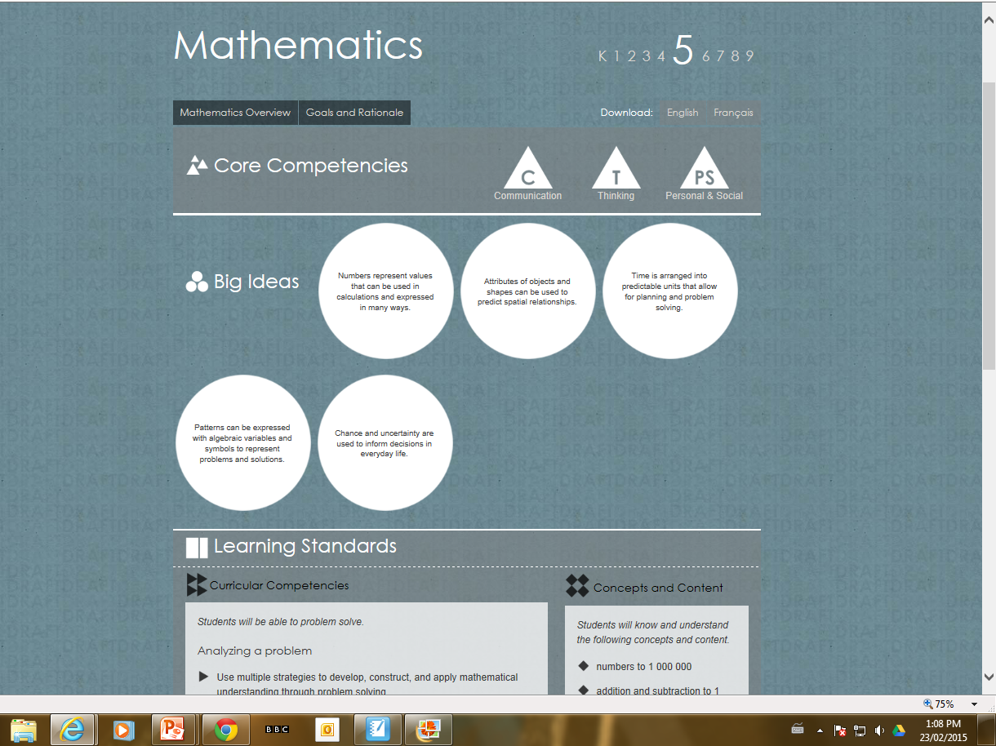
Notes:
All subject disciplines will have their curriculum organized using the same framework and template. This is an example of the Mathematics Grade 5 curriculum.

Slide 26
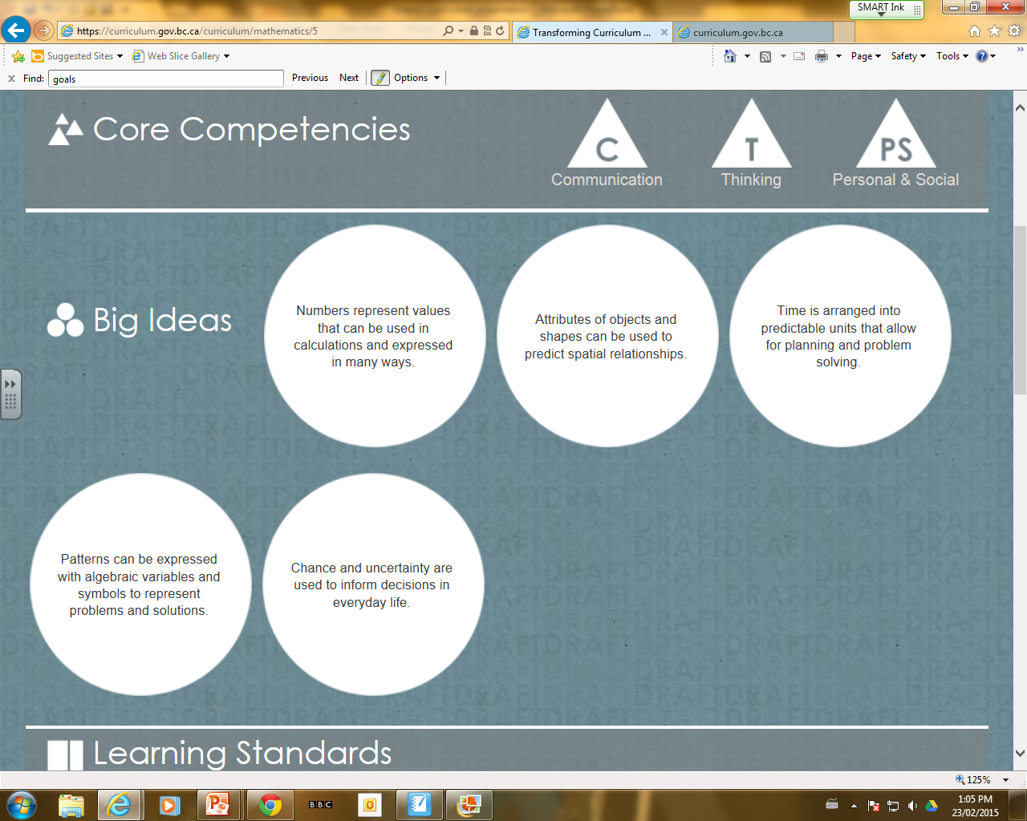
Notes:
A close-up of the Mathematics Grade 5 curriculum’s Core Competencies and Big Ideas.

Slide 27
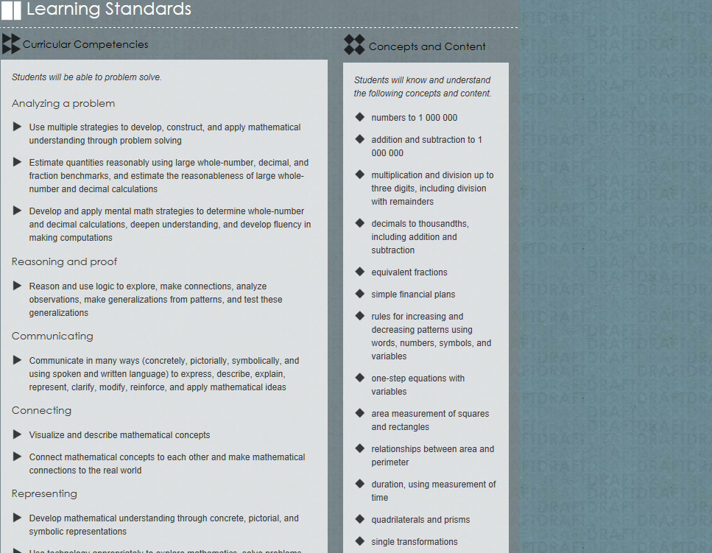
Notes:
A close-up of the Mathematics Grade 5 curriculum Curriculum Competencies and Concepts and Content.

Slide 28
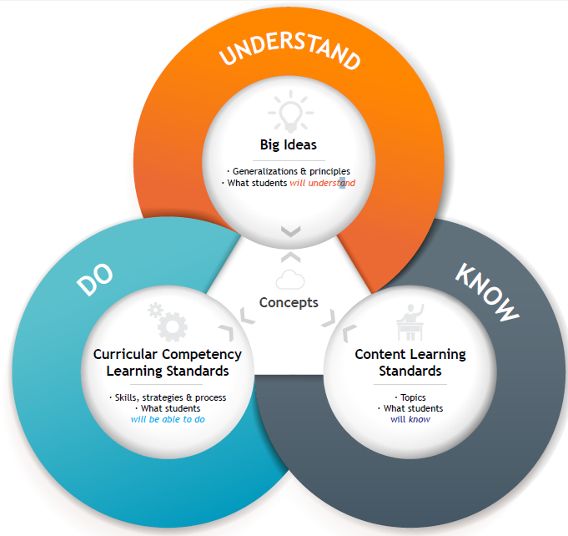
Notes:
This graphic illustrates how KDU model is interconnected by concepts. This model allows students' knowledge of course content and their application of curricular competencies to reach a deeper understanding of the bigger ideas.

Slide 29
KDU Model: Know, Do, Understand
Content: the KNOW, knowledge, facts, information
Curricular Competencies: the DO, skills, processes, strategies, Can-do statements, “how”
Big Ideas: the UNDERSTAND
One can’t DO anything, if one doesn’t KNOW anything
Notes:
How the KUD model is inter-connected and supported.

Slide 30
KDU Model:
3-dimensional
Facts and skills are not enough
Students raise their knowledge to a conceptual level (LUCID)
Shift from “covering facts” to “using facts and skills to understand concepts and big ideas”
Notes:
This 3-D learning model goes beyond learning facts and skills alone. Students will raise their knowledge to the conceptual level while practicing the competencies of the discipline. The goal is to create a shift from "covering facts" to "using facts and skills to understand concepts and big ideas"

Slide 31
Language is a vehicle to access culture
What could the KDU model look like for French?
-Use French to explore their
own cultural identity
-Demonstrate understanding
of common elements of
cultural stories in la Francophonie
-various idiomatic expressions across la Francophonie
-cultural stories from a variety of Francophone countries
Notes:
An illustration as to how the KUD model could work for Core French.

Slide 32
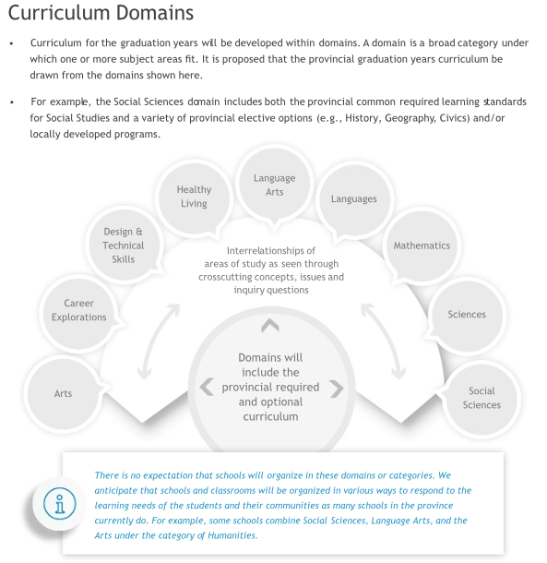
Core French Curriculum Highlights:
A workable draft for Gr.5-12 is ready for Ministry edits
Ministry of Education included the domain of Languages under the Graduation Years Curriculum Document (page 2)
Notes:
Second Language teachers will be pleased to learn that the Ministry of Education agreed to include the domain of Languages under the Graduation Years Curriculum: Proposed Directions. More info can be found at: https://curriculum.gov.bc.ca/sites/curriculum.gov.bc.ca/files/pdf/GradYrCurriculumDirections.pdf (page 2).

Slide 33
Core French Curriculum Highlights:
Transformative document; not a repackaging of “old-think”
Variety of pedagogies and approaches imbued into the new curriculum:
CEFR, TPRS, AIM, ACTFL, First Peoples Principles of Learning, LUCID, Communicative & Action-Oriented and more
Assessment and evaluation have not been discussed yet; likely to see greater reference to CEFR here
CEFR proficiency levels will not appear in final version
Notes:
In summary, these are some of the highlights of BC’s new Core French Curriculum, a transformative document.

Slide 34
Core French Curriculum Highlights:
The Front Matter will outline:
the philosophies and direction of the curriculum
what's new in this curriculum,
which elements of old curricula have been preserved,
how the new curriculum is concept-based and competency-driven and applicable to 21st century learning,
Inquiry-based learning,
real world connections and hands-on learning are always the essence of this new curriculum
Notes:
Some information that explains what parents and teachers can expect to see in the Front Matter of the new Core French curriculum.

Slide 35
Timeline approximations:
May - October: Instructional samples submitted
Late summer 2015: Core French curriculum draft posted
Sept - Dec. 2015: Draft open for feedback from the field
Jan - Feb. 2016: Revision phase to begin
Summer 2016: post revised version on web
Notes:
These timelines are only approximations.

Slide 36
Celebrating the completion of the curriculum writing process for grades 5-12, April 24, 2015.

Slide 37
bcatml.weebly.com/curriculum-info.html
Further curriculum updates are found at:
@BCATML
Notes:
Visit BCATML’s curriculum information page for further updates as they become available.

Slide 39
This presentation was compiled by: Nancy Griffith-Zahner, Stacia Johnson, Rome Lavrencic, and Stacey Sveistrup

